Slide 1


Slide 2
PROBLEM?????

Slide 3
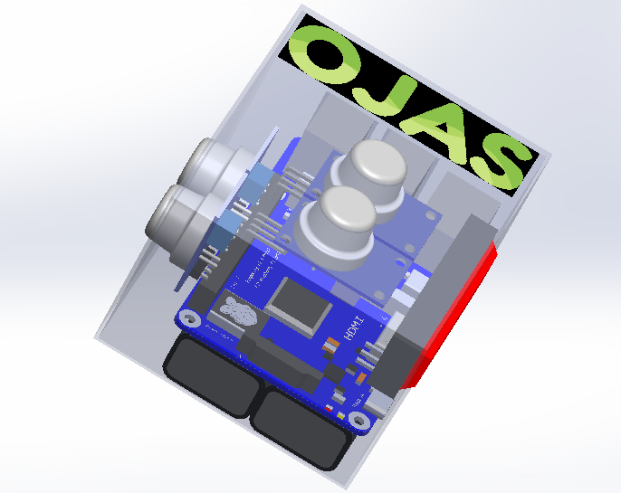
SOLUTION!!!!!!! OJAS-THE MODULE
MQ-4
MQ-7
MQ-5
MQ-2
SOS Button
Battery

Slide 4
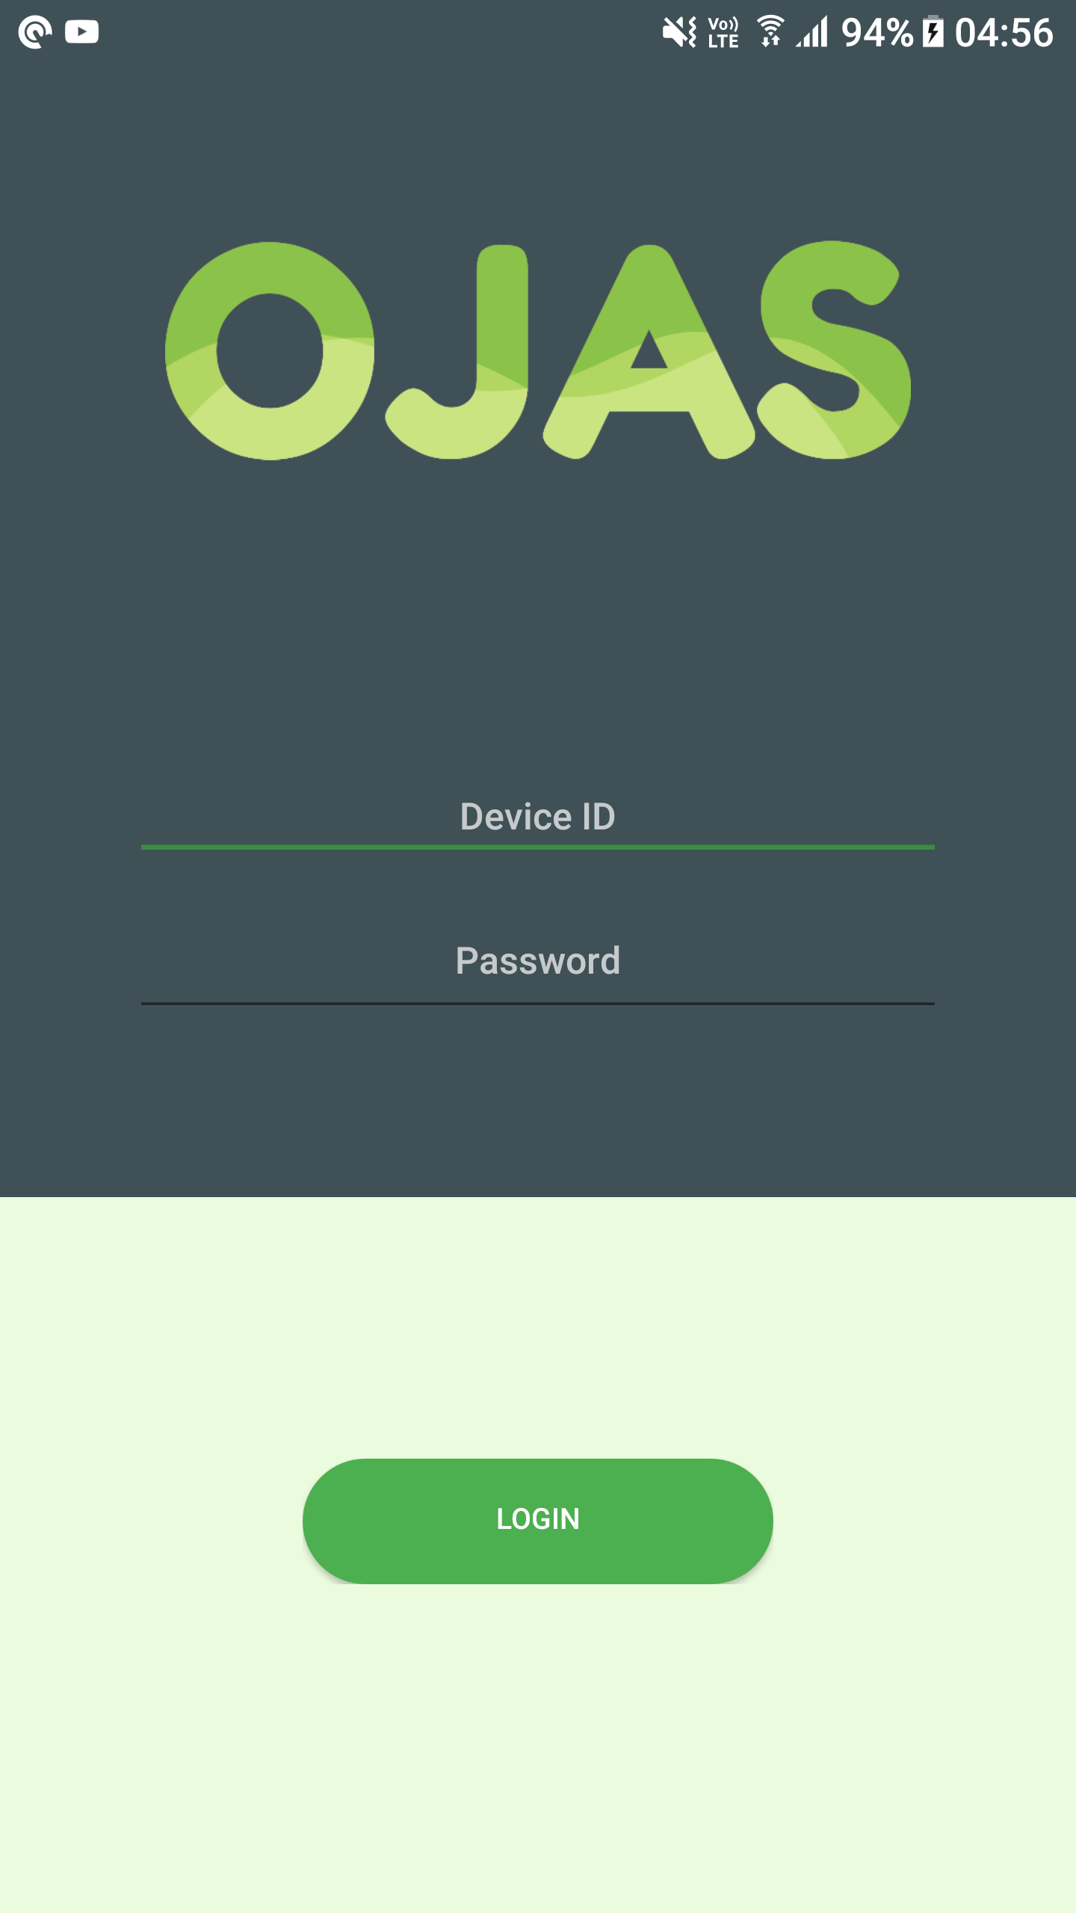
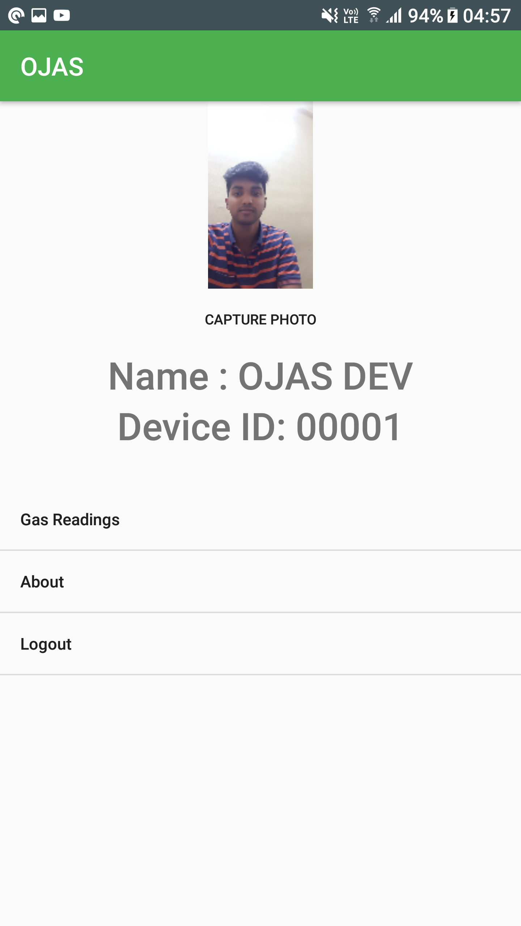
SOLUTION!!!!!! OJAS-THE APPLICATION

Slide 5
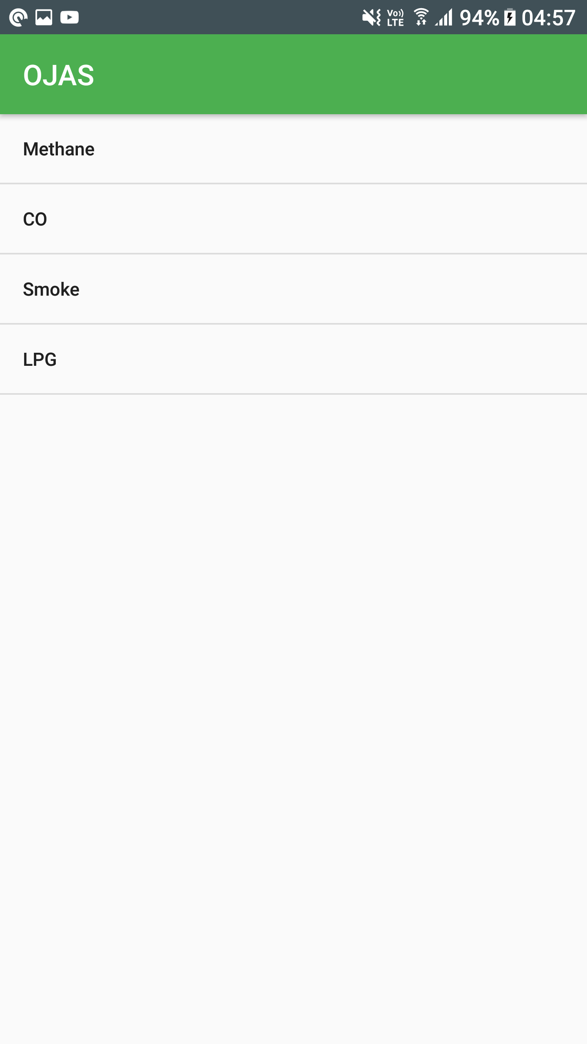
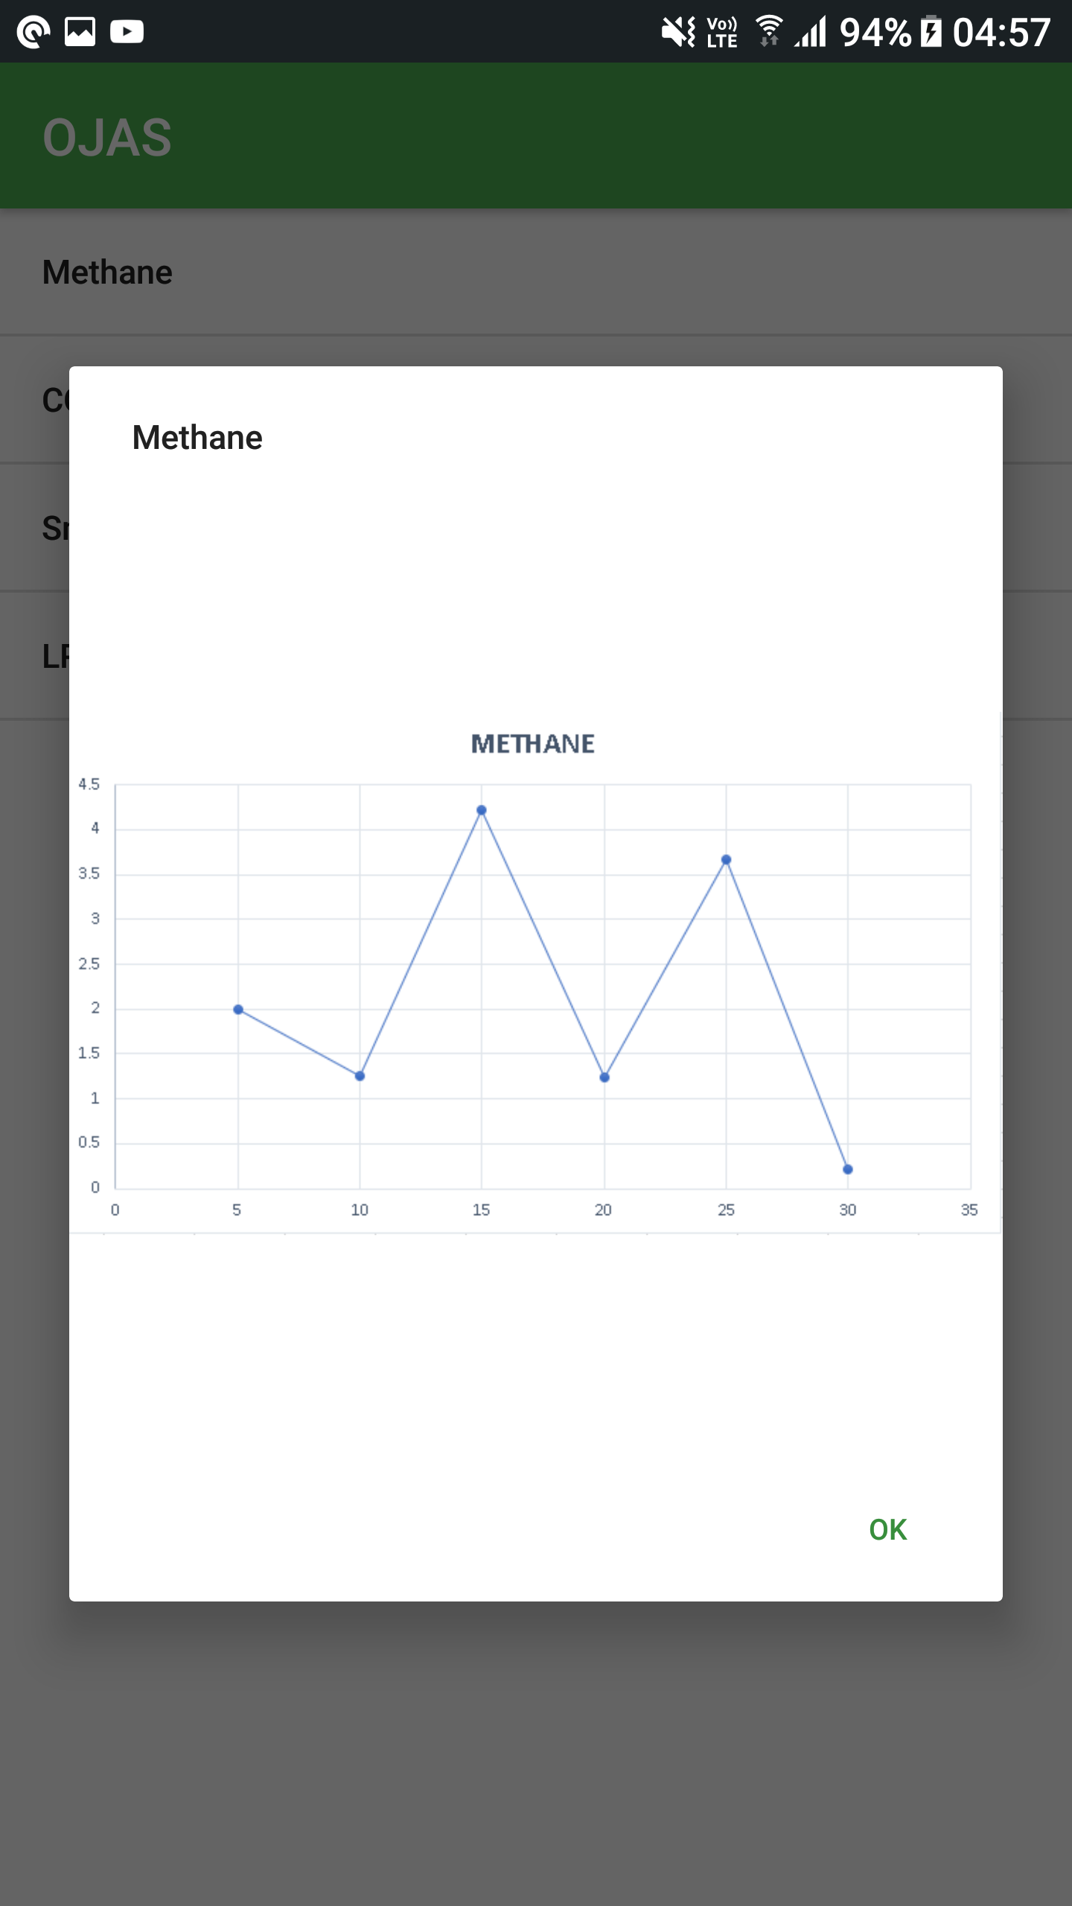
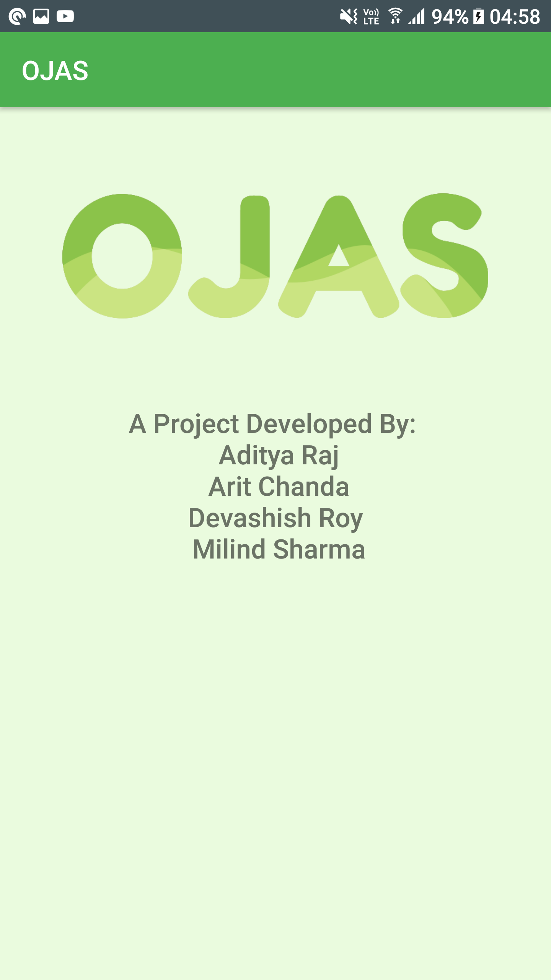

Slide 6
THANK YOU

